Slide 1
Chapter 2
Database System Concepts and Architecture

Slide 2
Chapter 2 Outline
Data Models, Schemas, and Instances
Three-Schema Architecture and Data Independence
Database Languages and Interfaces
The Database System Environment
Centralized and Client/Server Architectures
for DBMSs
Classification of Database Management Systems

Slide 3
Database System Concepts and Architecture
Basic client/server DBMS architecture
  Client module
  - client module is typically designed so that it will run on a user workstation or personal computer. Typically, application programs and user interfaces that access the database run in the client module.
  Server module
  - server module, typically handles data storage, access, search, and other functions

Slide 4
Data Models, Schemas, and Instances
Data abstraction
  Suppression of details of data organization and storage
  Highlighting of the essential features for an improved understanding of data

Slide 5
Data Models, Schemas, and Instances (cont'd.)
Data model
  Collection of concepts that describe the structure of a database
  Provides means to achieve data abstraction
  Basic operations
    Specify retrievals and updates on the database
  Dynamic aspect or behavior of a database application
    Allows the database designer to specify a set of valid operations allowed on database objects
    Example: the operation “COMPUTE-GPA” which can be applied to the database object “Student”

Slide 6
Categories of Data Models
High-level or conceptual data models
  Provide concepts that are close to the way many users perceive data.
Low-level or physical data models
  Describe the details of how data is stored on computer storage media
  Concepts provided by low-level data models are generally meant for computer specialists, not for end users.
Representational (implementation) data models
  Between conceptual and physical data models
  Easily understood by end users
  Also similar to how data organized in computer storage

Slide 7
Categories of Data Models (cont'd.)
Conceptual data model uses concepts such as entities, attributes, and relationships
Entity
  Represents a real-world object or concept
Attribute
  Represents some property of interest that further describes an entity
Relationship among two or more entities
  Represents an association among the entities
  Entity-Relationship model

Slide 8
Categories of Data Models (cont'd.)
Relational data model
  Used most frequently in traditional commercial DBMSs
Object data model
  New family of higher-level implementation data models
  Closer to conceptual data models

Slide 9
Categories of Data Models (cont'd.)
Physical data models
  Describe how data is stored as files in the computer
  Access path
    Structure that makes the search for particular database records efficient
  Index
    Example of an access path
    Allows direct access to data using an index term or a keyword

Slide 10
Schemas, Instances, and Database State
Database schema
  Description of a database is called schema
Schema diagram
  Displays selected aspects of schema
  A displayed schema is called schema diagram.
  Example of database in figure 1.2 is shown in figure 2.1
Schema construct
  Each object in the schema such as Student; course, etc.
Database state or snapshot
  Data in database at a particular moment in time

Slide 11
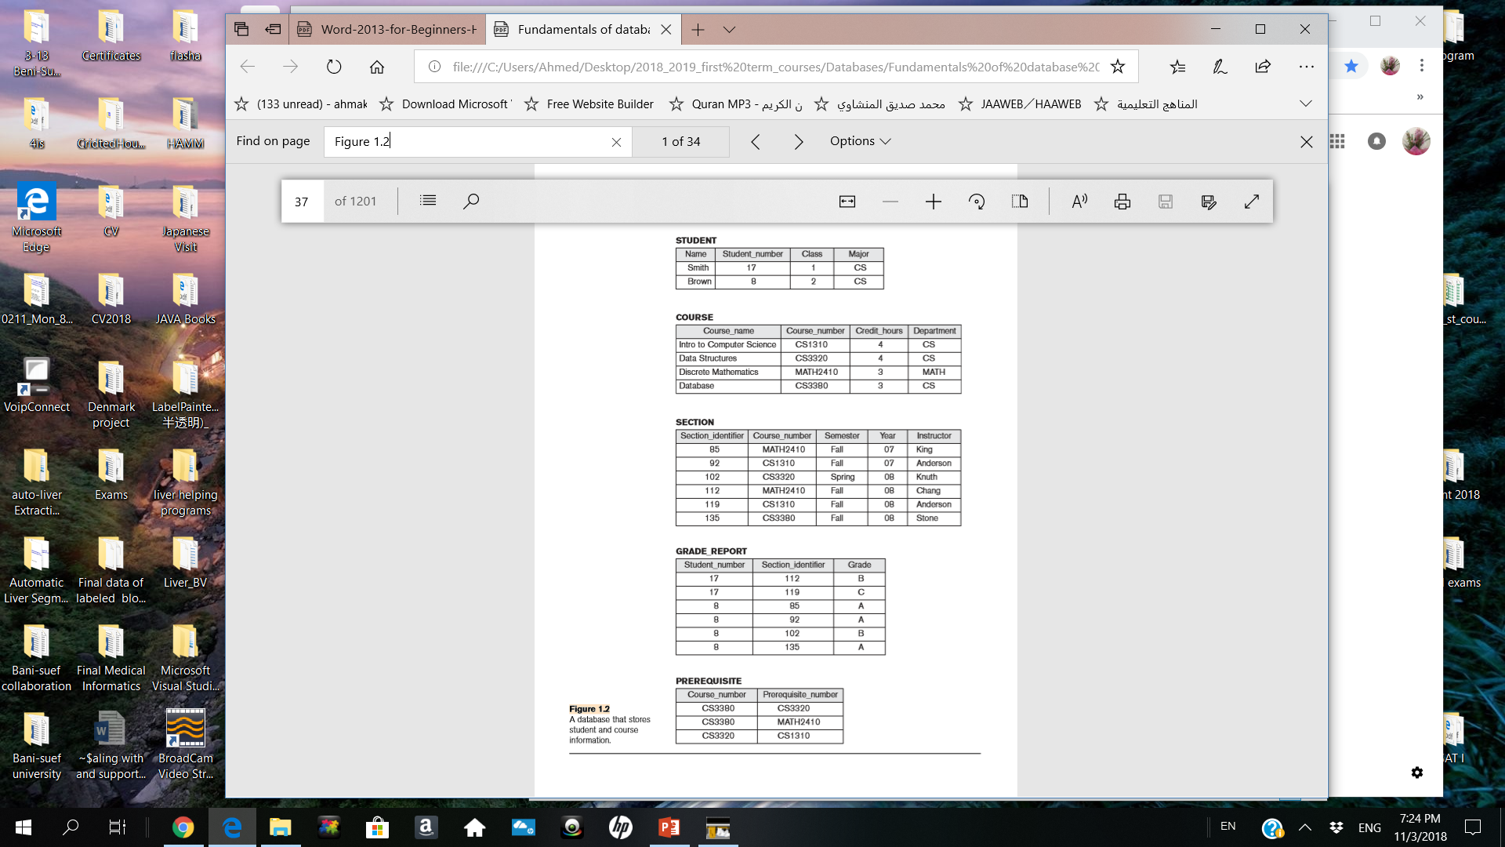
Example of
a database

Slide 12
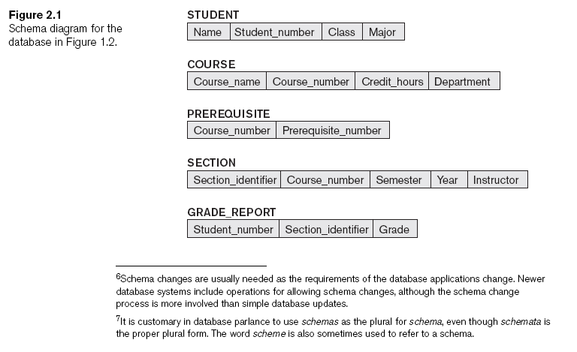
Schemas, Instances, and Database State (cont'd.)
Schema diagram of the example in figure 1.2

Slide 14
. In a given database state, each schema construct has its own current set of instances; for example, the STUDENT construct will contain the set of individual student entities (records) as its instances.
Every time we insert or delete a record or change the value of a data item in a record, we change one state of the database into another state.

Slide 15
Schemas, Instances, and Database State (cont'd.)
When we define a new database (database schema)
  Specify database schema to the DBMS
  The corresponding database state is the empty state with no data.
Initial state
  Populated or loaded with the initial data
Valid state
  Satisfies the structure and constraints specified in the schema of the database.
  Notice: The DBMS stores the description of the schema constructs and constrains which is called Meta-Data

Slide 16
Schemas, Instances, and Database State (cont'd.)
Schema evolution
  Changes applied to schema as application requirements change for example if we would like to add “date of birth” to the entity “student”, the schema will change
  .Most modern DBMSs include some operations for schema evolution that can be applied while the database is operational
Example:
Old schema
New or evolution of schema
Name | Student_number | Class | Major | Date of birth

Slide 17
Three-Schema Architecture and Data Independence
The goal of this three-schema architecture is to separate the user applications from the physical database.
This three-schema architecture include internal level, conceptual level and external level.
Internal level
  Describes physical storage structure (full details) of database.
Conceptual level
  Describes structure of the whole database for a community of users, hiding the details of physical storage structures.
External or view level
  Describes part of the database that a particular user group is interested in and hides the rest of the database from that user group.

Slide 18
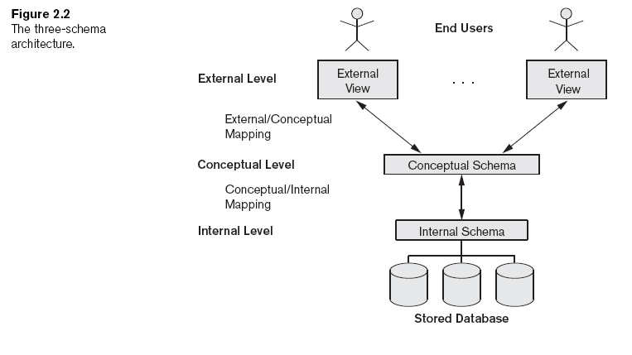
Three-Schema Architecture and Data Independence (cont'd.)
Different users have different views

Slide 19
Data Independence
Capacity to change the schema at one level of a database system
  Without having to change the schema at the next higher level
Types:
  Logical
  Physical

Slide 20
DBMS Languages
Data definition language (DDL)
  Defines both conceptual and internal schemas
  DDL is applied when no strict separation level is maintained.
Storage definition language (SDL)
  Specifies the internal schema
  SDL is applied when a strict separation of internal and conceptual levels is maintained.
View definition language (VDL)
  Specifies user views/mappings to conceptual schema
Data manipulation language (DML)
  Allows retrieval, insertion, deletion, modification

Slide 22
DBMS Languages (cont'd.)
High-level or nonprocedural DML
  Can be used on its own to specify complex database operations concisely
  Set-at-a-time or set-oriented
Low-level or procedural DML
  Must be embedded in a general-purpose programming language
  Record-at-a-time

Slide 23
DBMS Interfaces
Menu-based interfaces for Web clients or browsing
Forms-based interfaces
Graphical user interfaces
Natural language interfaces
Speech input and output
Interfaces for parametric users
Interfaces for the DBA

Slide 24
The Database System Environment
DBMS component modules
  Buffer management
  Stored data manager
  DDL compiler
  Interactive query interface
    Query compiler
    Query optimizer
  Precompiler

Slide 25
The Database System Environment (cont'd.)
DBMS component modules
  Runtime database processor
  System catalog
  Concurrency control system
  Backup and recovery system

Slide 26
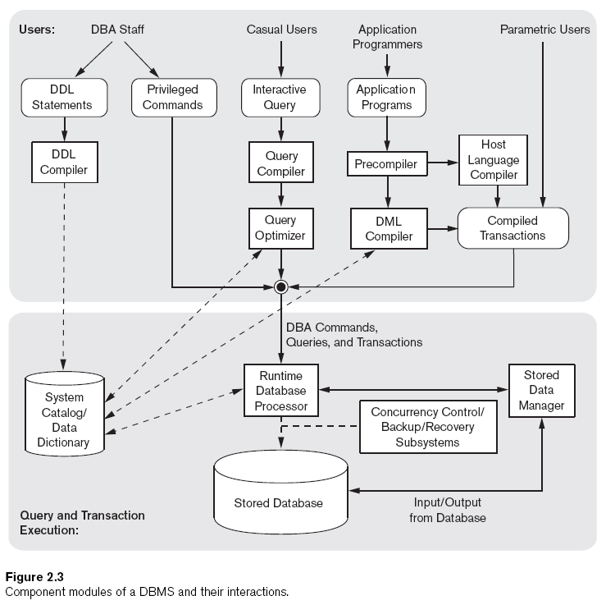

Slide 27
Database System Utilities
Loading
  Load existing data files
Backup
  Creates a backup copy of the database

Slide 28
Database System Utilities (cont'd.)
Database storage reorganization
  Reorganize a set of database files into different file organizations
Performance monitoring
  Monitors database usage and provides statistics to the DBA

Slide 29
Tools, Application Environments, and Communications Facilities
CASE Tools
Data dictionary (data repository) system
  Stores design decisions, usage standards, application program descriptions, and user information
Application development environments
Communications software

Slide 30
Centralized and Client/Server Architectures for DBMSs
Centralized DBMSs Architecture
  All DBMS functionality, application program execution, and user interface processing carried out on one machine

Slide 31
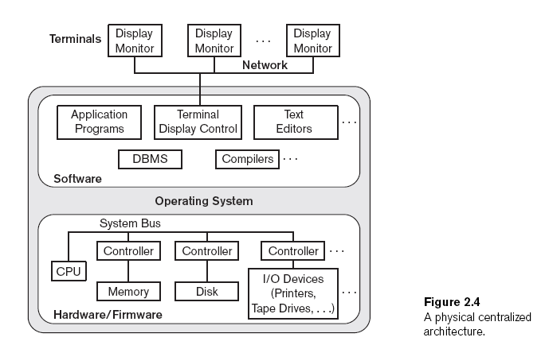

Slide 32
Basic Client/Server Architectures
Servers with specific functionalities
  File server
    Maintains the files of the client machines.
  Printer server
    Connected to various printers; all print requests by the clients are forwarded to this machine
  Web servers or e-mail servers

Slide 33
Basic Client/Server Architectures (cont'd.)
Client machines
  Provide user with:
    Appropriate interfaces to utilize these servers
    Local processing power to run local applications

Slide 34
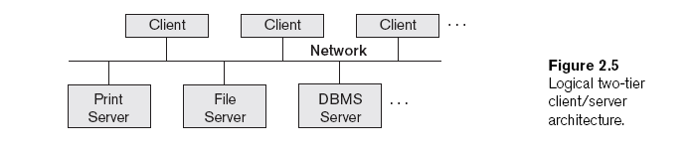
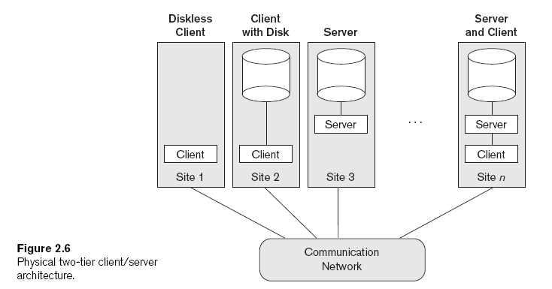

Slide 35
Basic Client/Server Architectures (cont'd.)
Client
  User machine that provides user interface capabilities and local processing
Server
  System containing both hardware and software
  Provides services to the client machines
    Such as file access, printing, archiving, or database access

Slide 36
Two-Tier Client/Server Architectures for DBMSs
Server handles
  Query and transaction functionality related to SQL processing
Client handles
  User interface programs and application programs

Slide 37
Two-Tier Client/Server Architectures (cont'd.)
Open Database Connectivity (ODBC)
  Provides application programming interface (API)
  Allows client-side programs to call the DBMS
    Both client and server machines must have the necessary software installed
JDBC
  Allows Java client programs to access one or more DBMSs through a standard interface

Slide 38
Three-Tier and n-Tier Architectures for Web Applications
Application server or Web server
  Adds intermediate layer between client and the database server
  Runs application programs and stores business rules
N-tier
  Divide the layers between the user and the stored data further into finer components

Slide 39
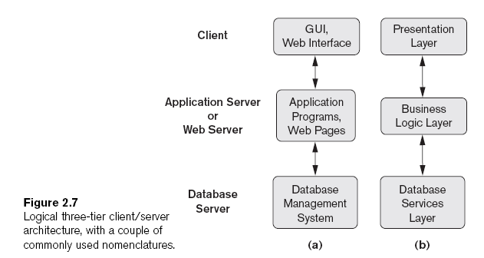

Slide 40
Classification of Database
Management Systems
Data model
  Relational
  Object
  Hierarchical and network (legacy)
  Native XML DBMS
Number of users
  Single-user
  Multiuser

Slide 41
Classification of Database
Management Systems (cont'd.)
Number of sites
  Centralized
  Distributed
    Homogeneous
    Heterogeneous
Cost
  Open source
  Different types of licensing

Slide 42
Classification of Database
Management Systems (cont'd.)
Types of access path options
General or special-purpose

Slide 43
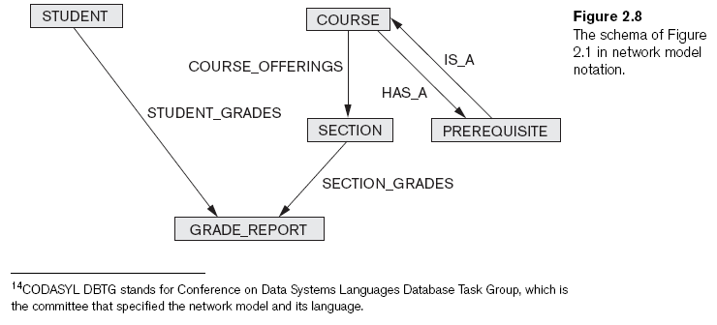
Classification of Database
Management Systems (cont'd.)

Slide 44
Summary
Concepts used in database systems
Main categories of data models
Types of languages supported by DMBSs
Interfaces provided by the DBMS
DBMS classification criteria:
  Data model, number of users, number of sties, access paths, cost

